Slide 1
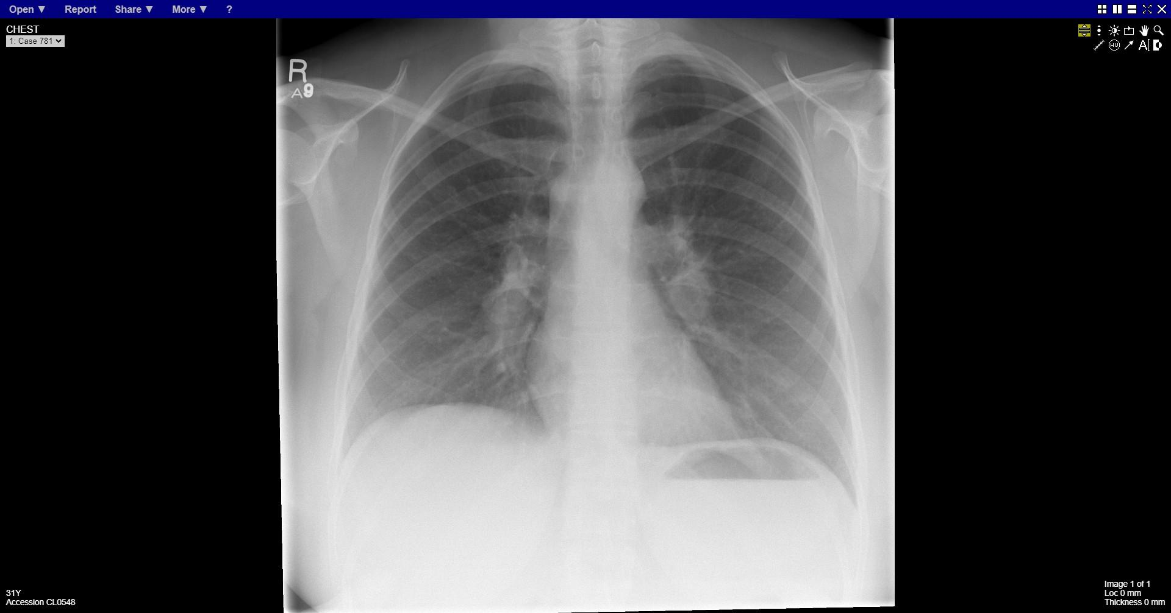
Notes:
Bilateral hilar lymphadenopathy

Slide 2
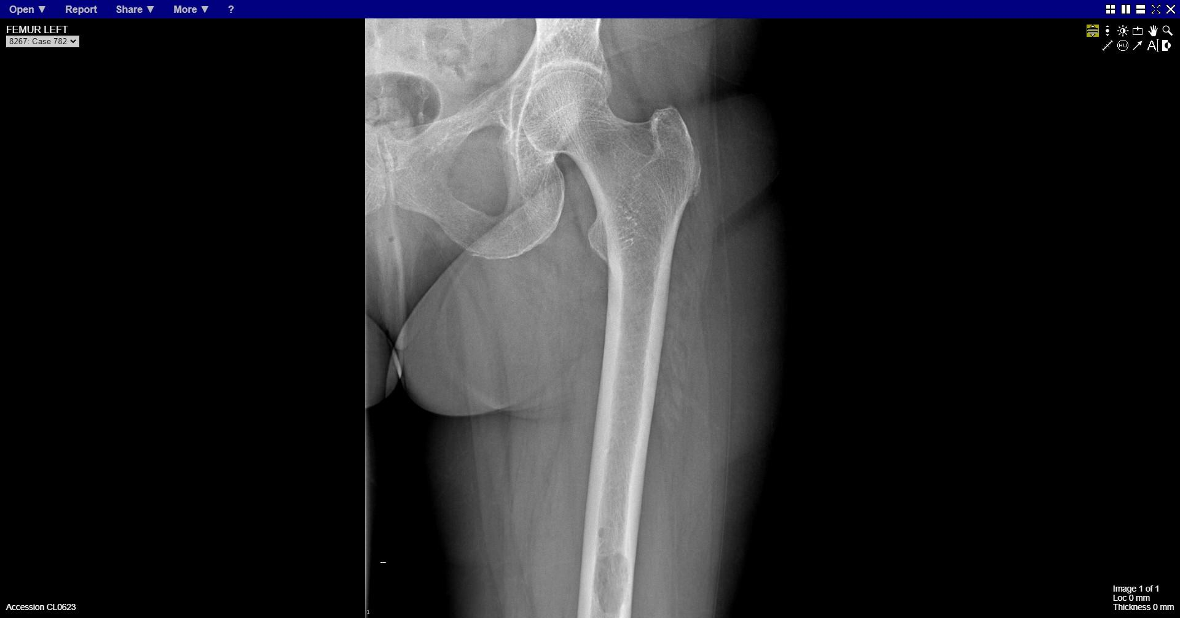
Notes:
Lytic lesion midshaft femur

Slide 3
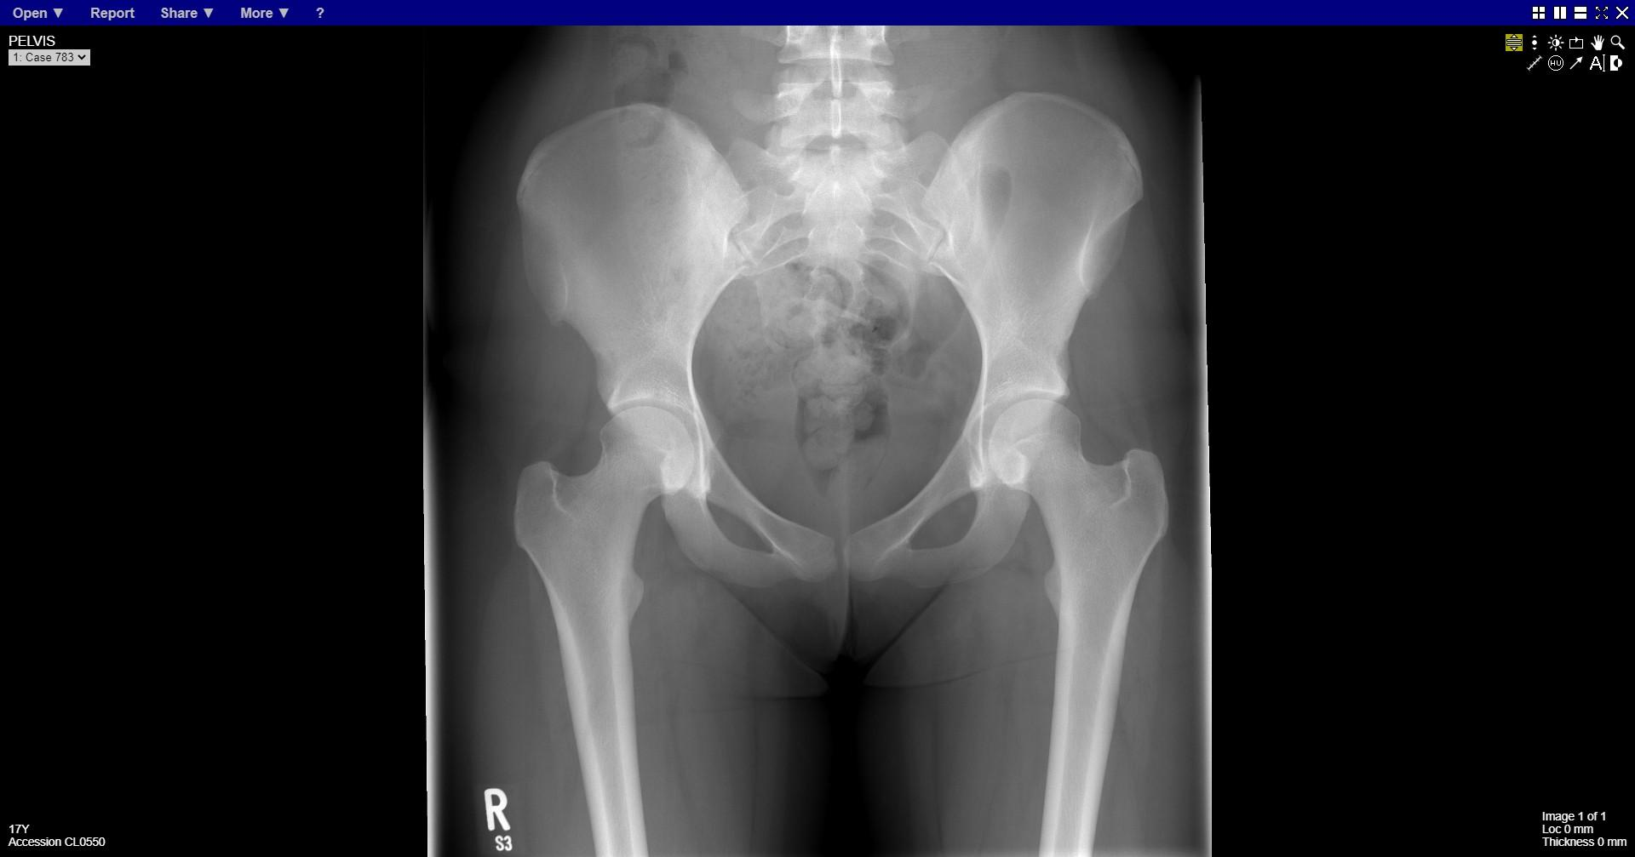
Notes:
normal

Slide 4
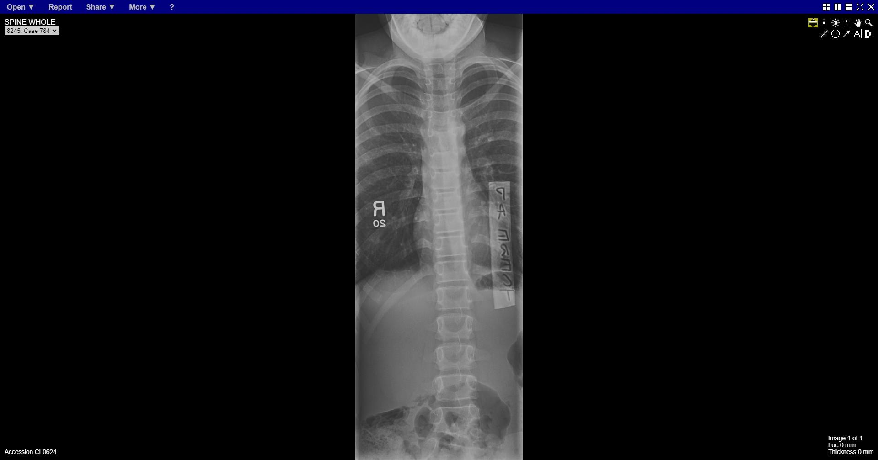
Notes:
Abnormal L5 vertebral body
?hemivertebrae

Slide 5
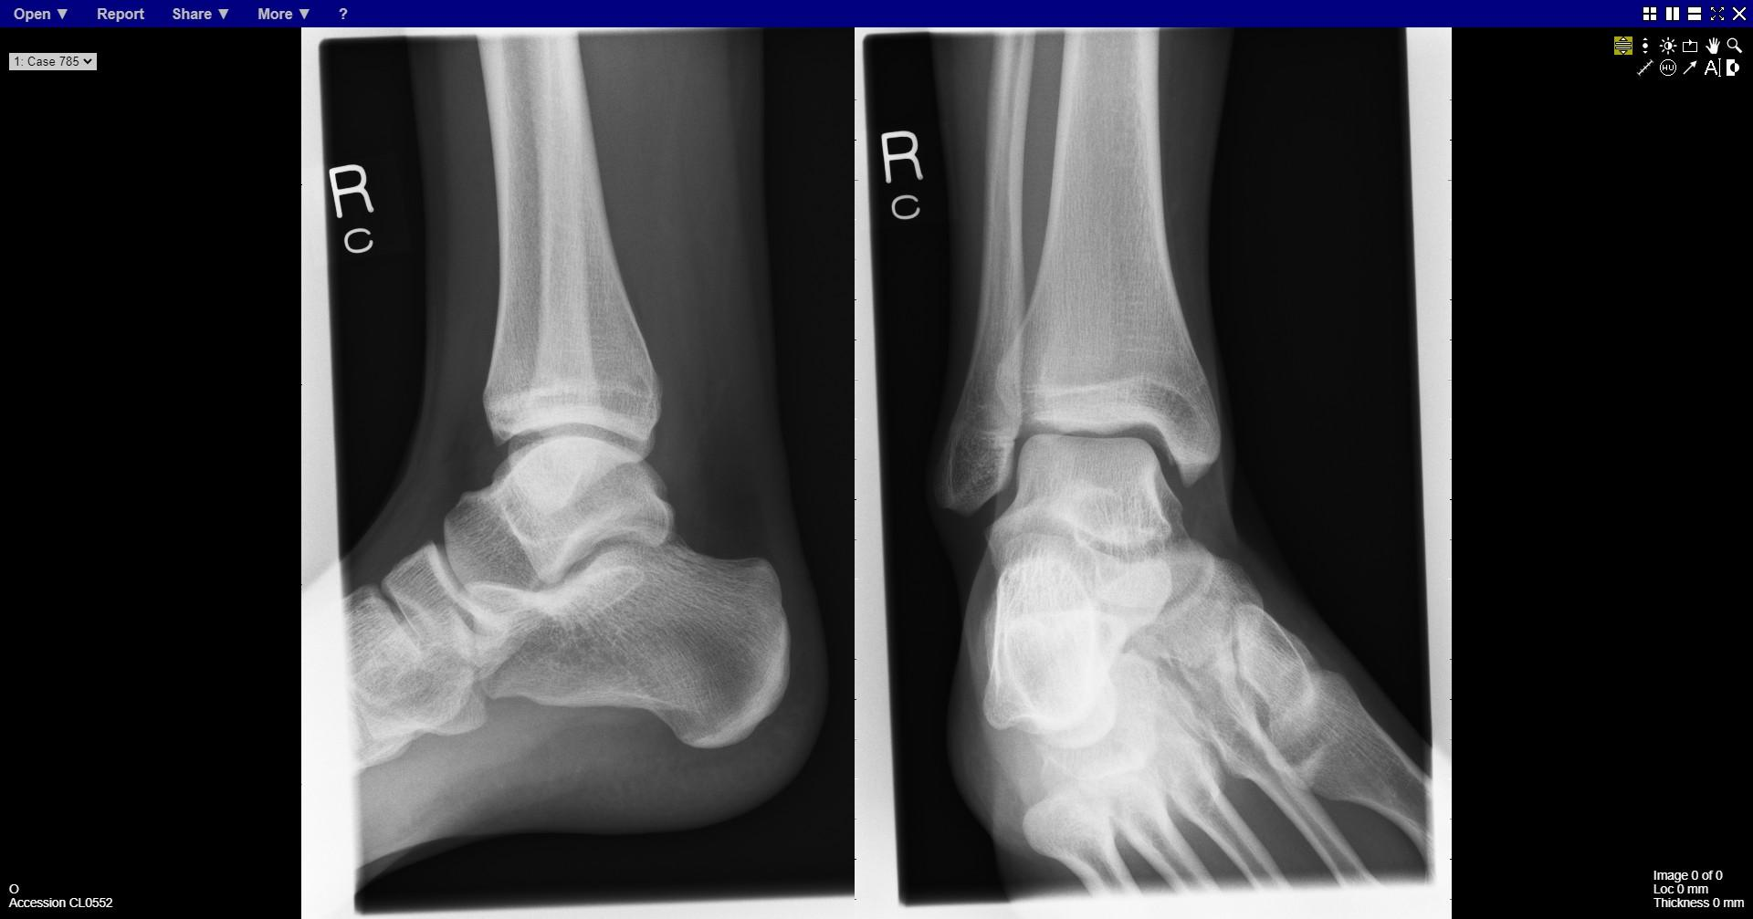
Notes:
normal

Slide 6
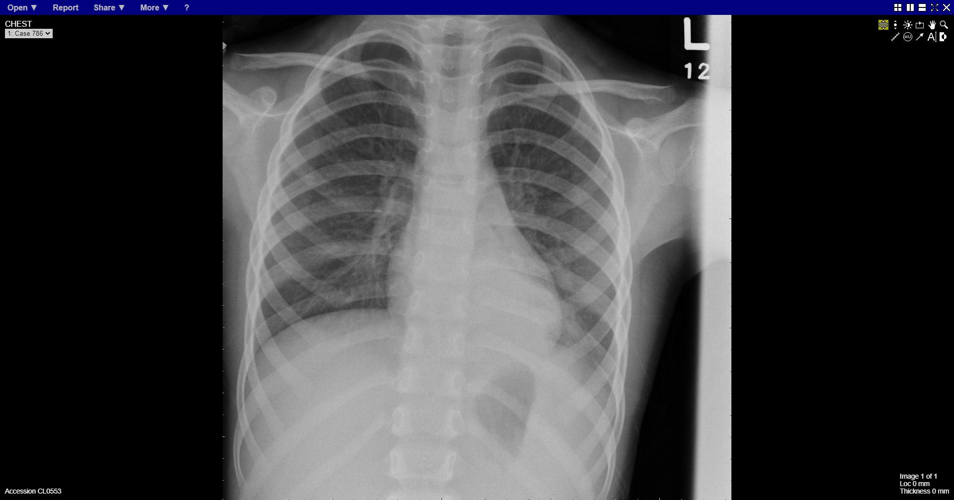
Notes:
Left lower lobe consolidation

Slide 7
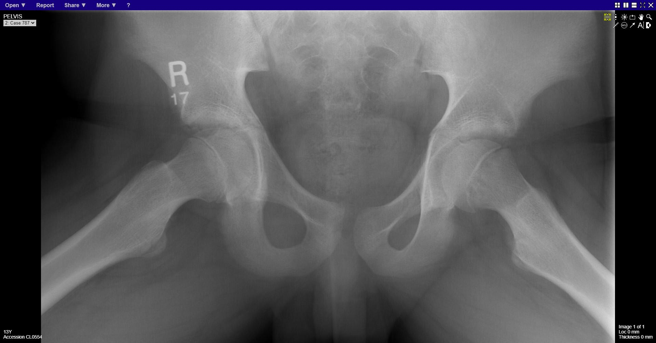
Notes:
Left SUFE

Slide 8
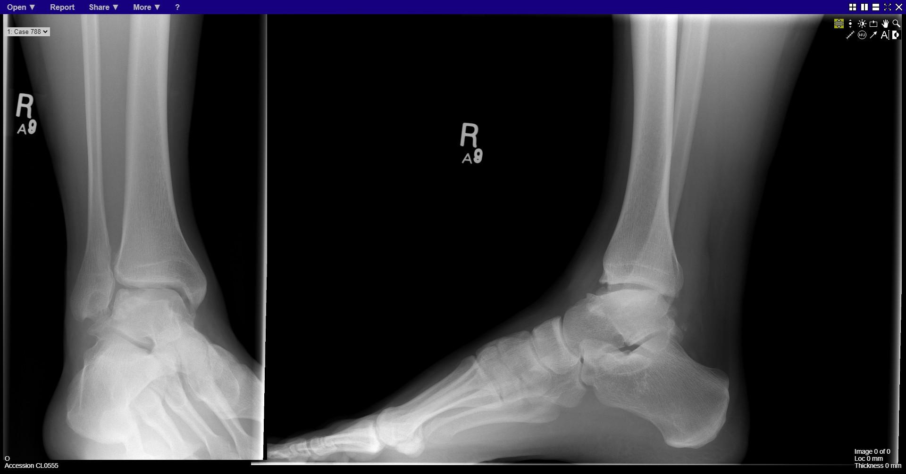
Notes:
Avascular necrosis talar dome

Slide 9
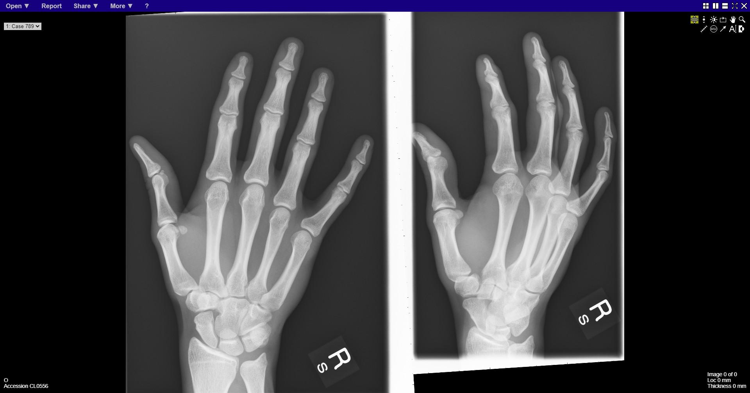
Notes:
normal

Slide 10
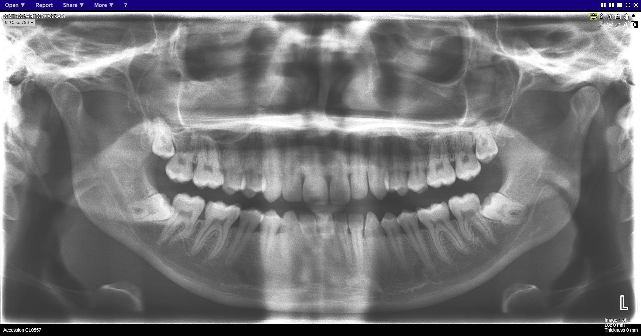
Notes:
normal

Slide 11
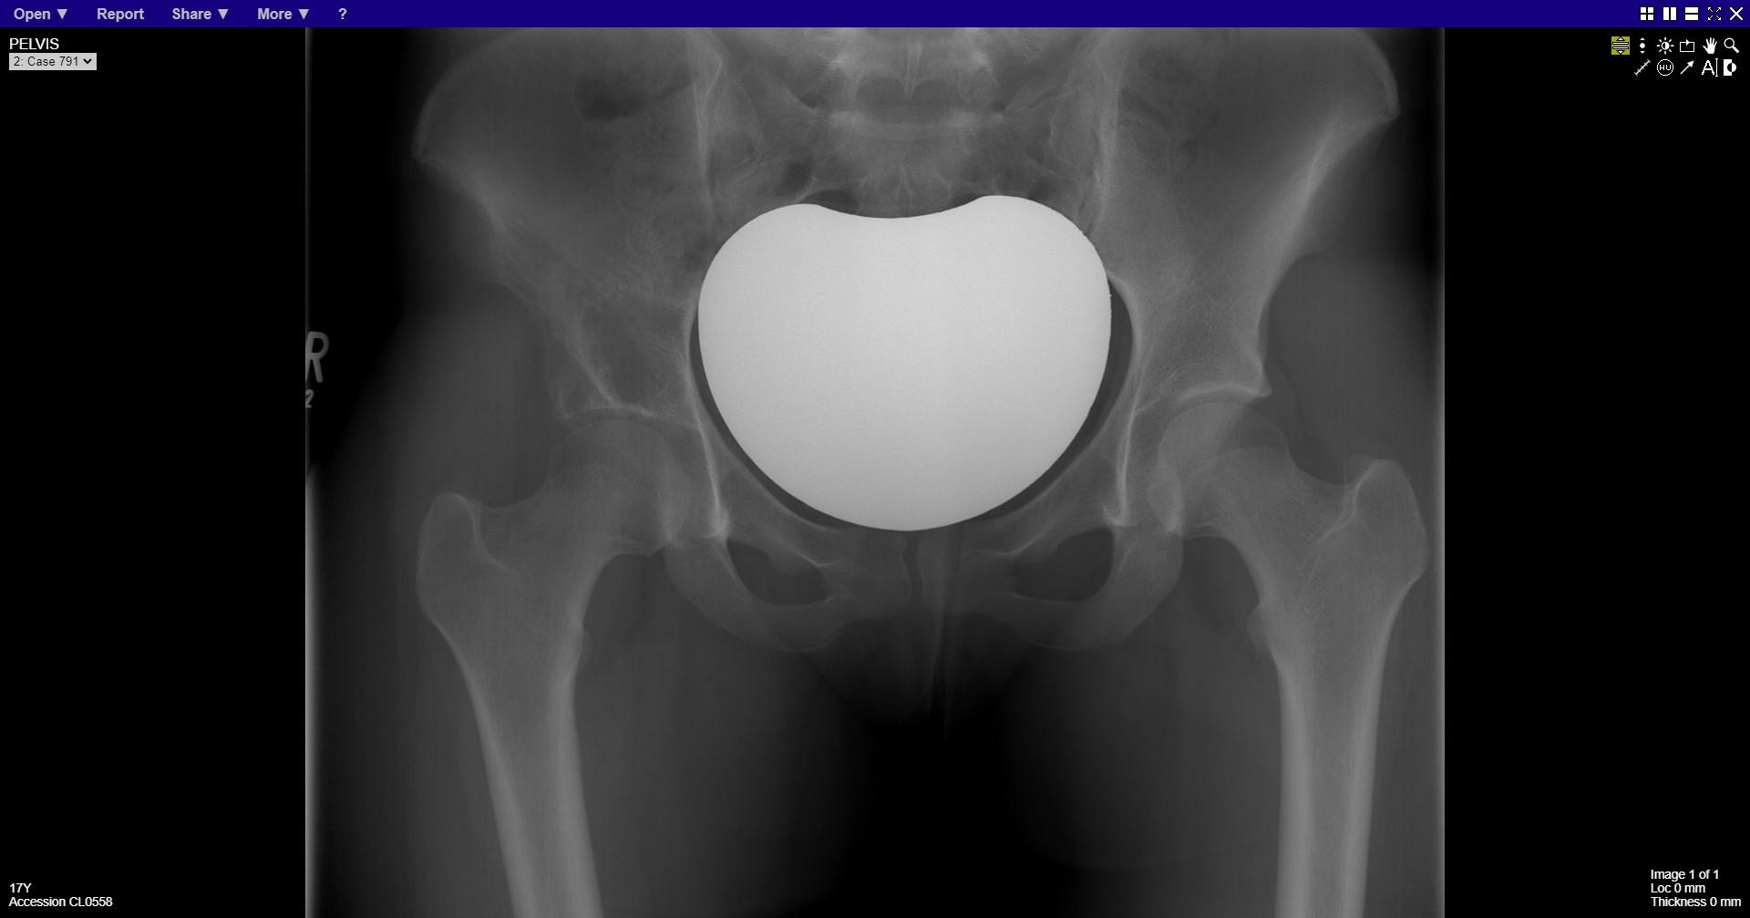
Notes:
Lytic lesion right ilium

Slide 12
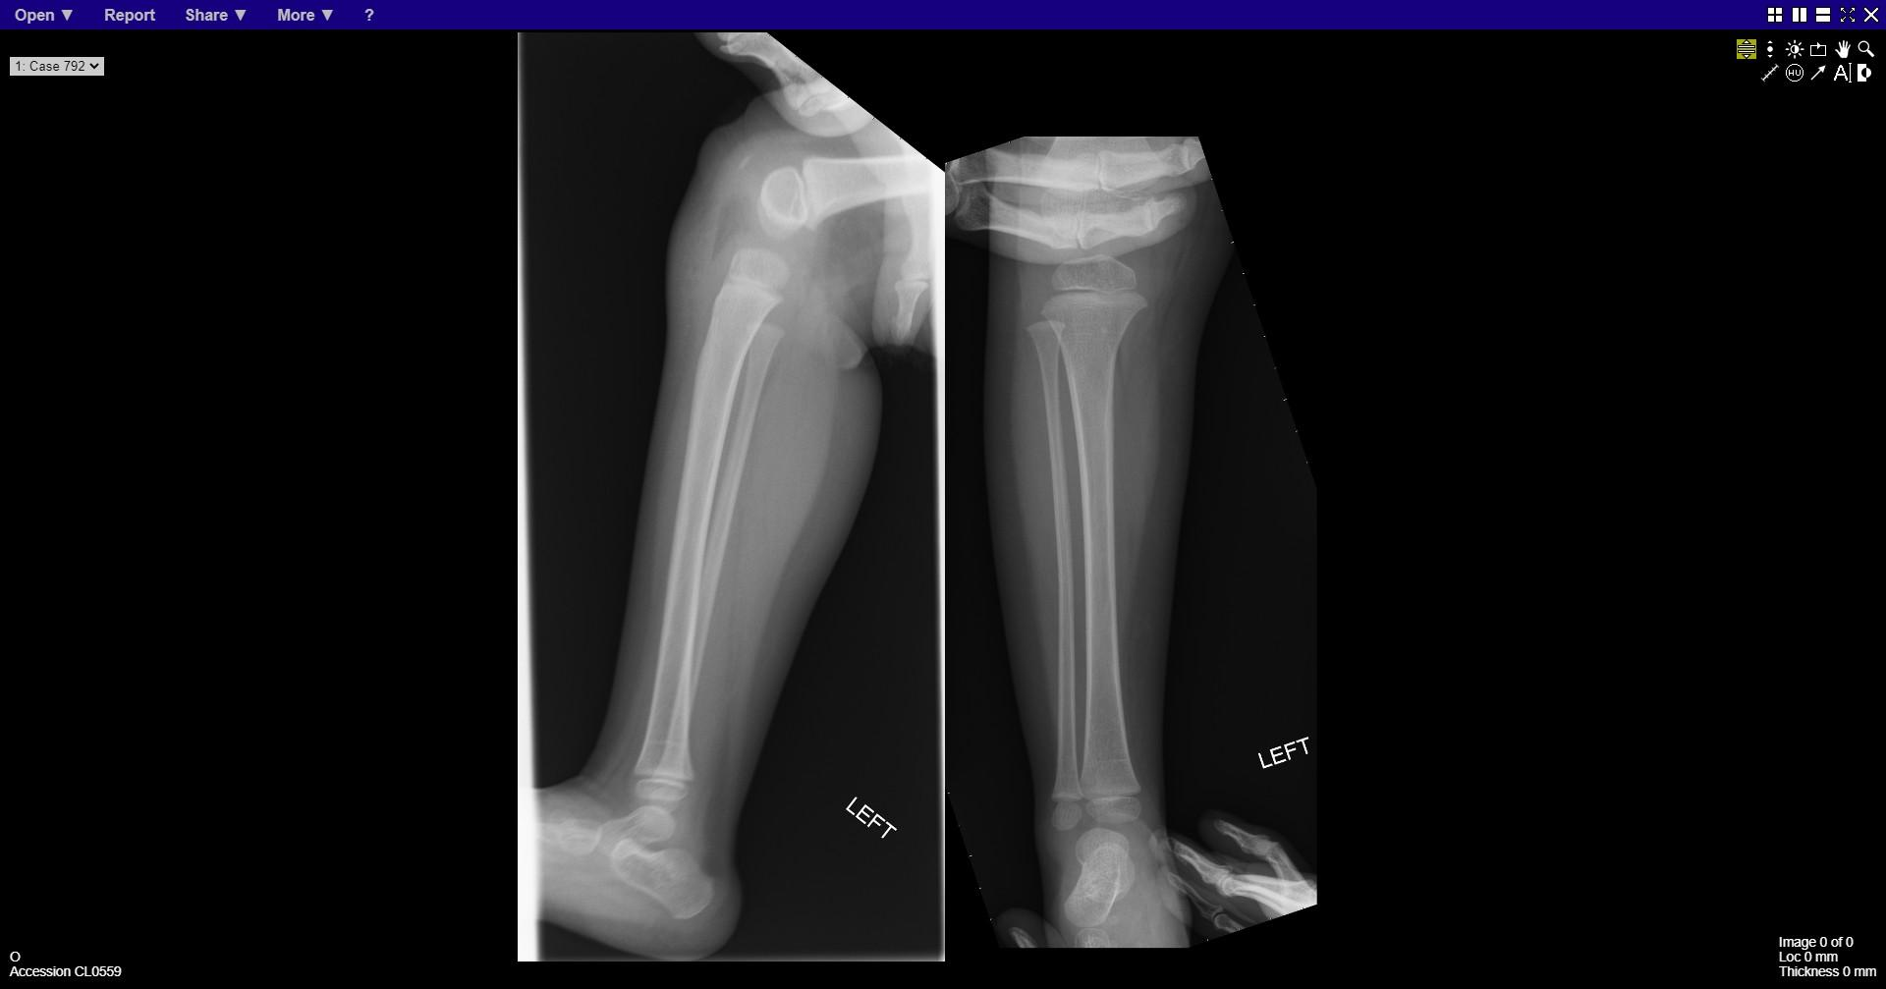
Notes:
normal

Slide 13
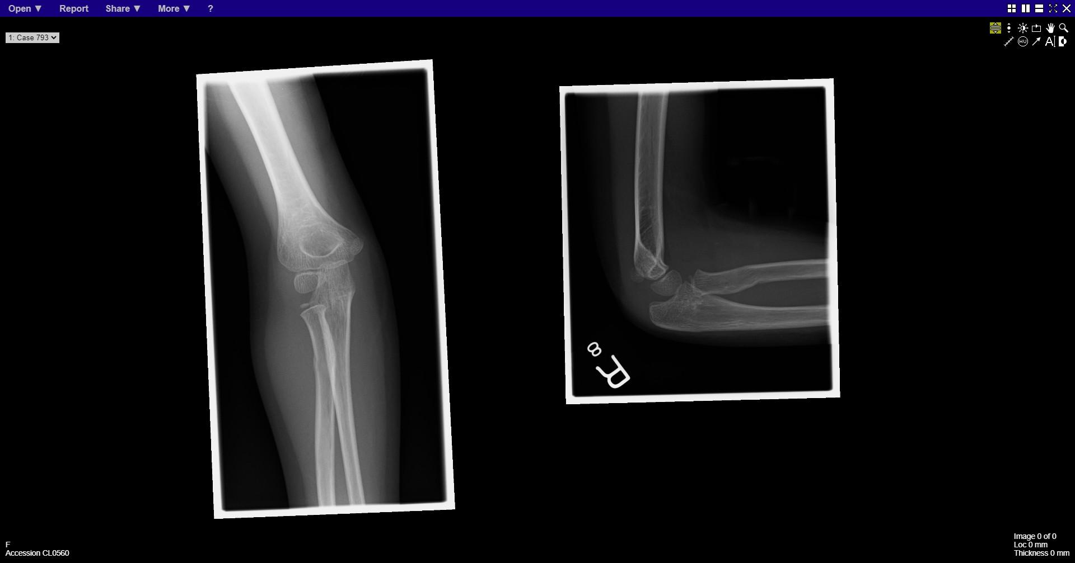
Notes:
Buckle fracture proximal radius shaft

Slide 14
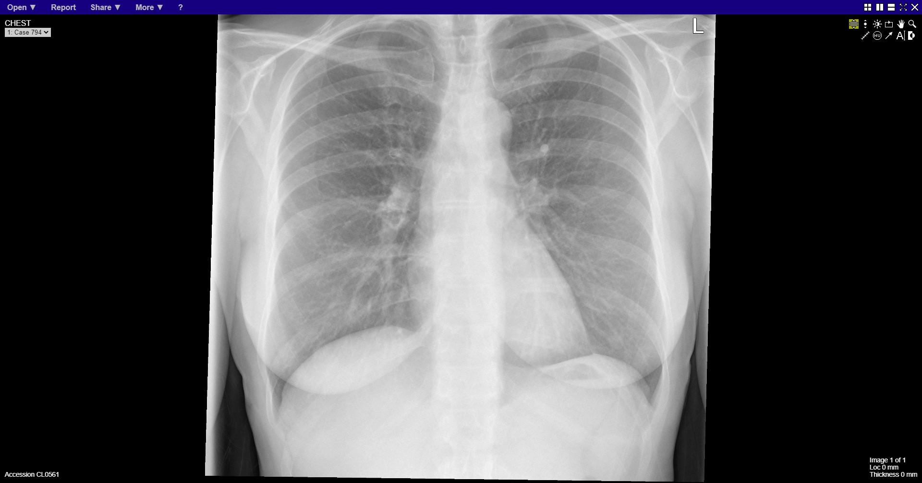
Notes:
normal

Slide 15
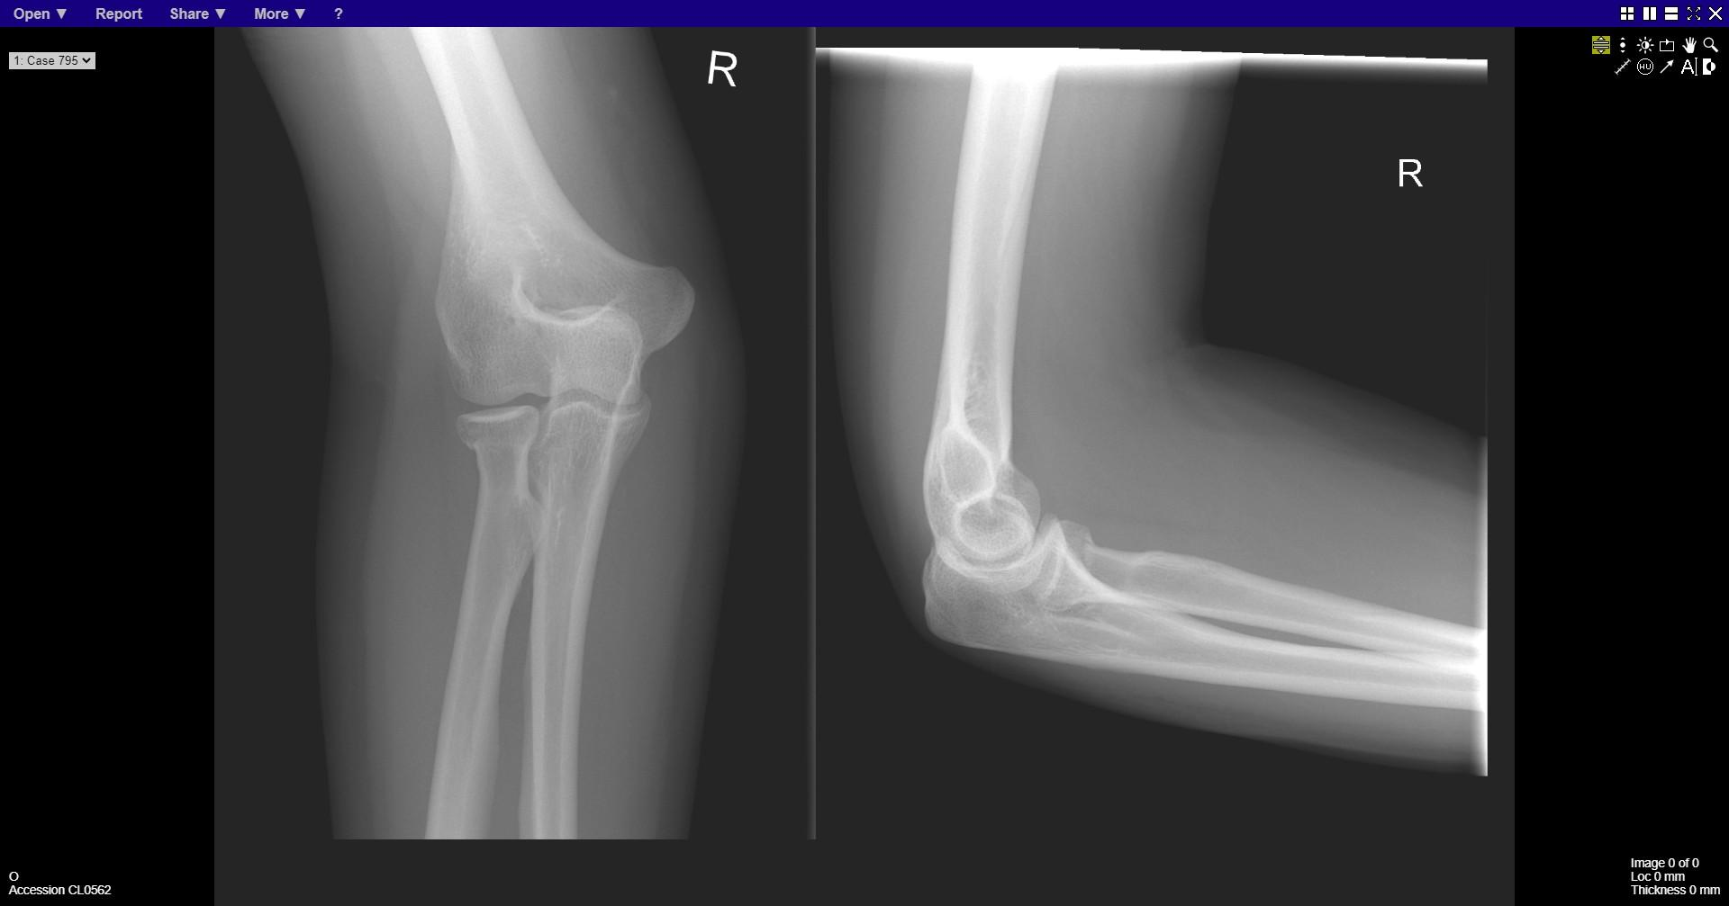
Notes:
Radial neck fracture

Slide 16
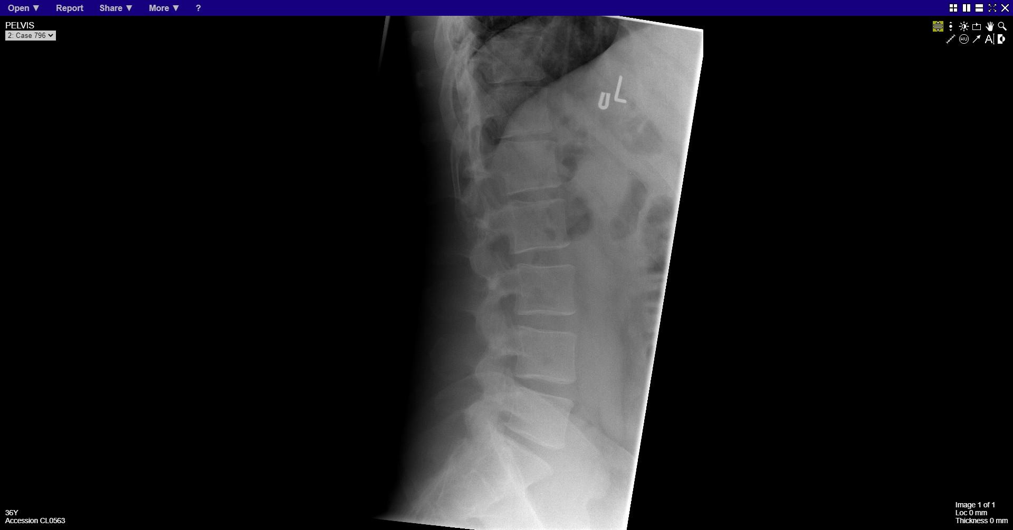
Notes:
normal

Slide 17
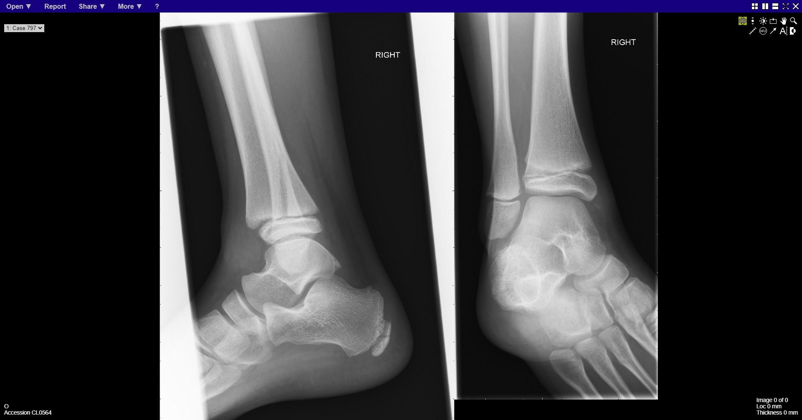
Notes:
Fracture distal tibia – SH2

Slide 18
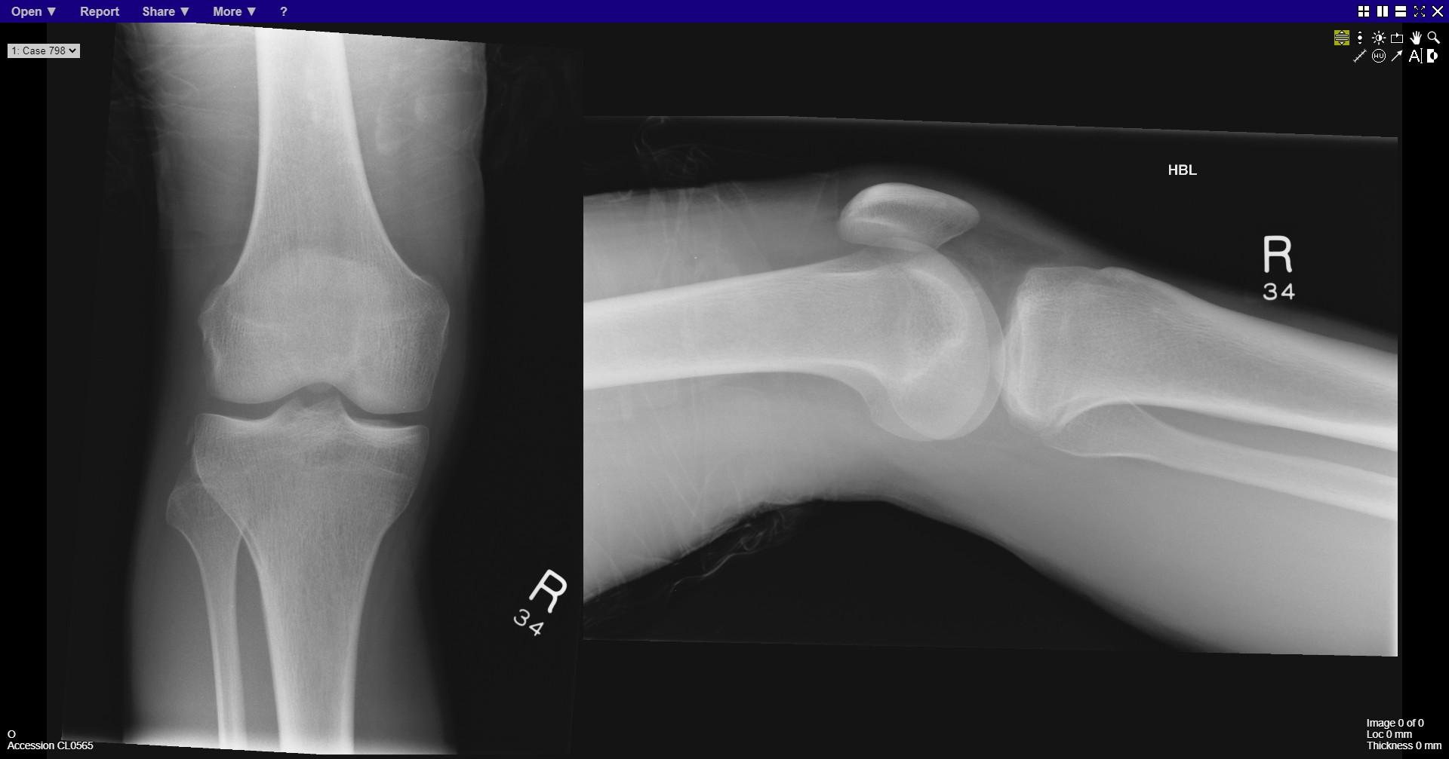
Notes:
Small fragment avulsed from lateral condyle of tibia - Segond fracture

Slide 19
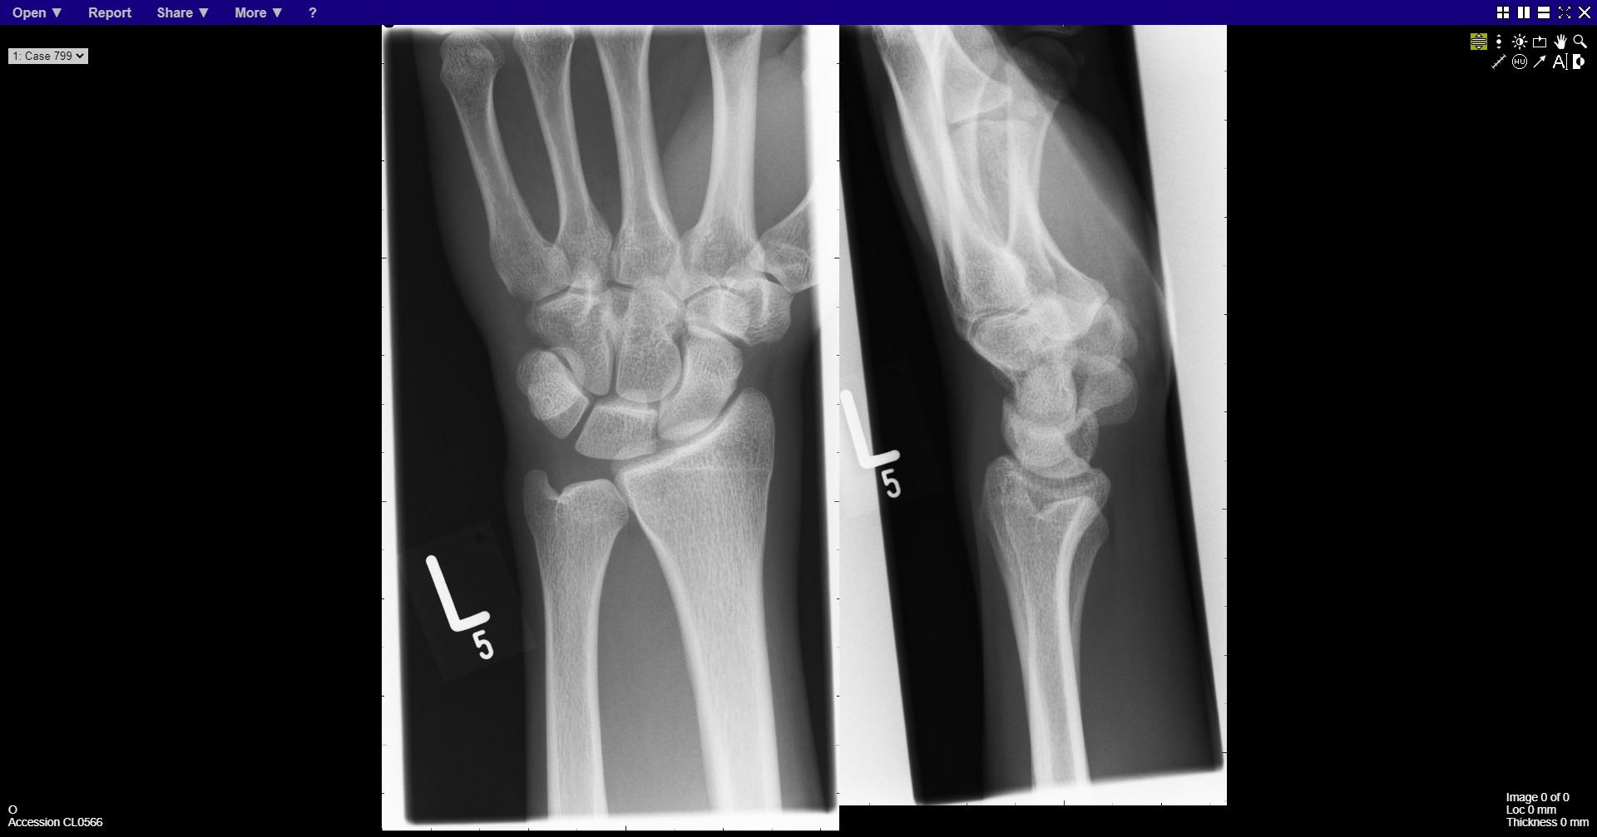
Notes:
normal

Slide 20
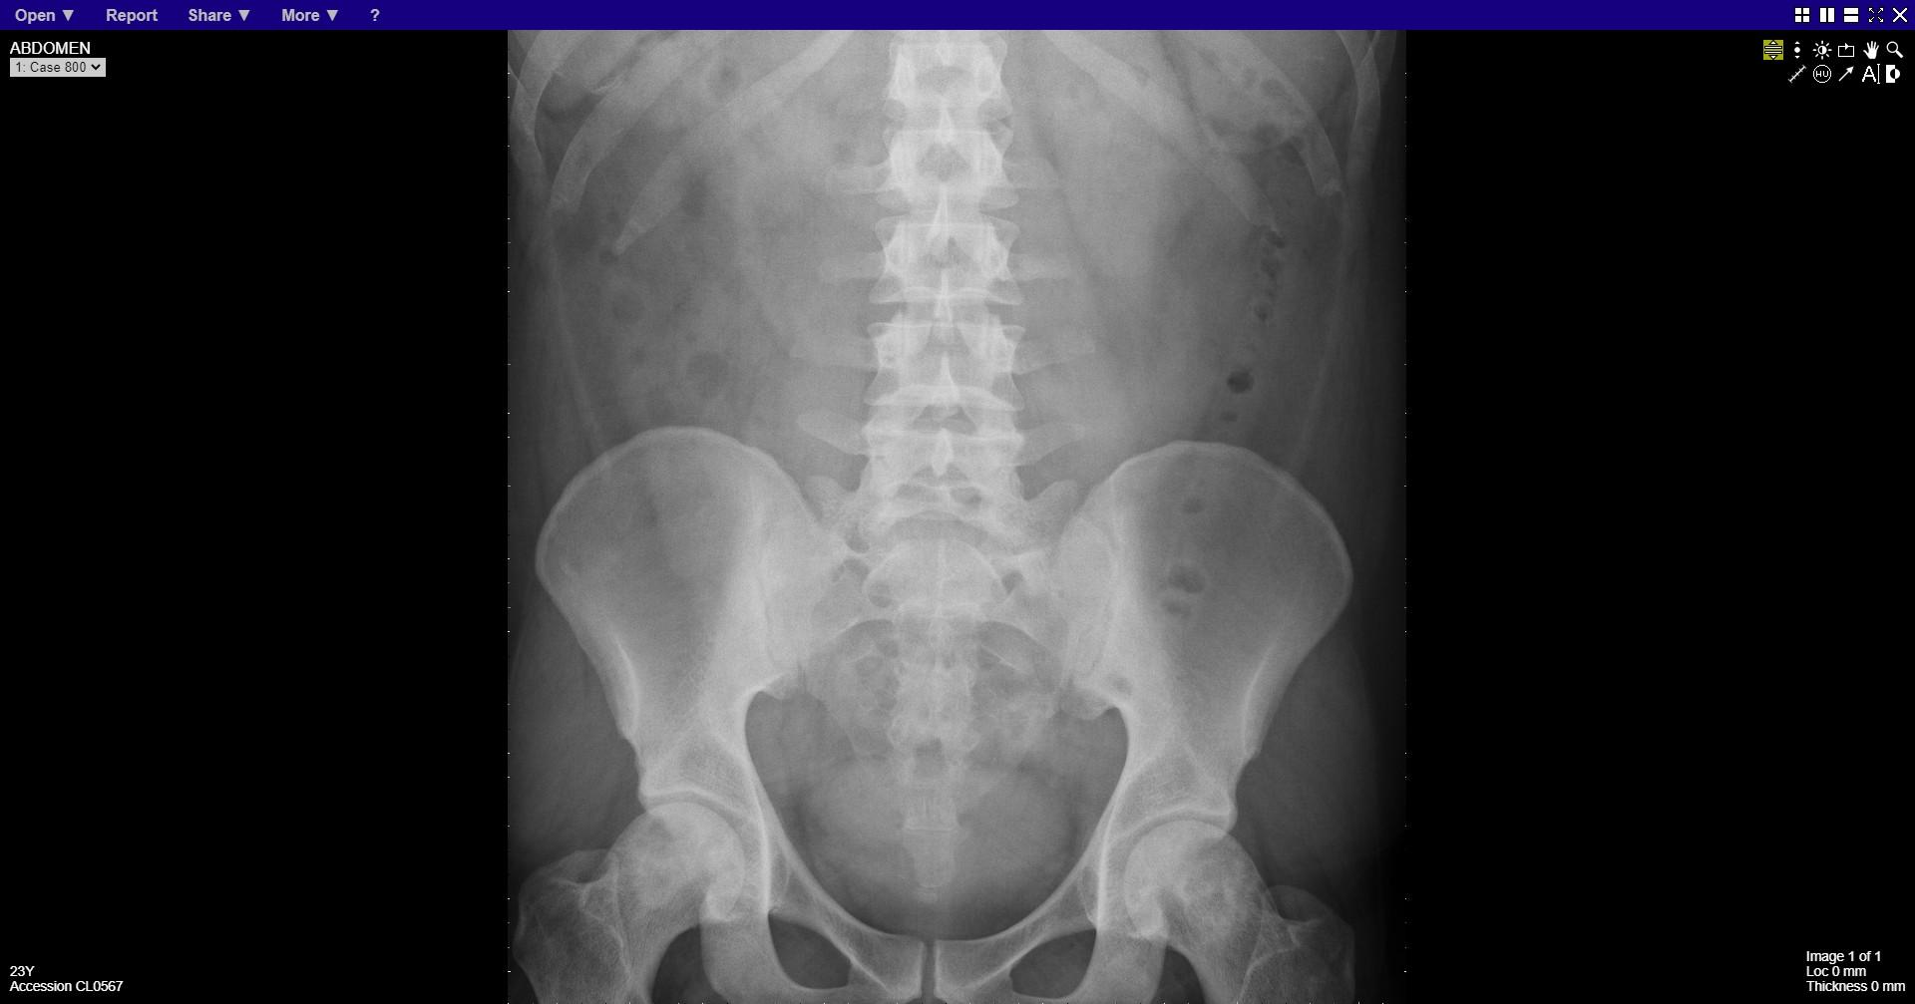
Notes:
Bilateral avascular necrosis of femoral heads
Splenomegaly

Slide 21
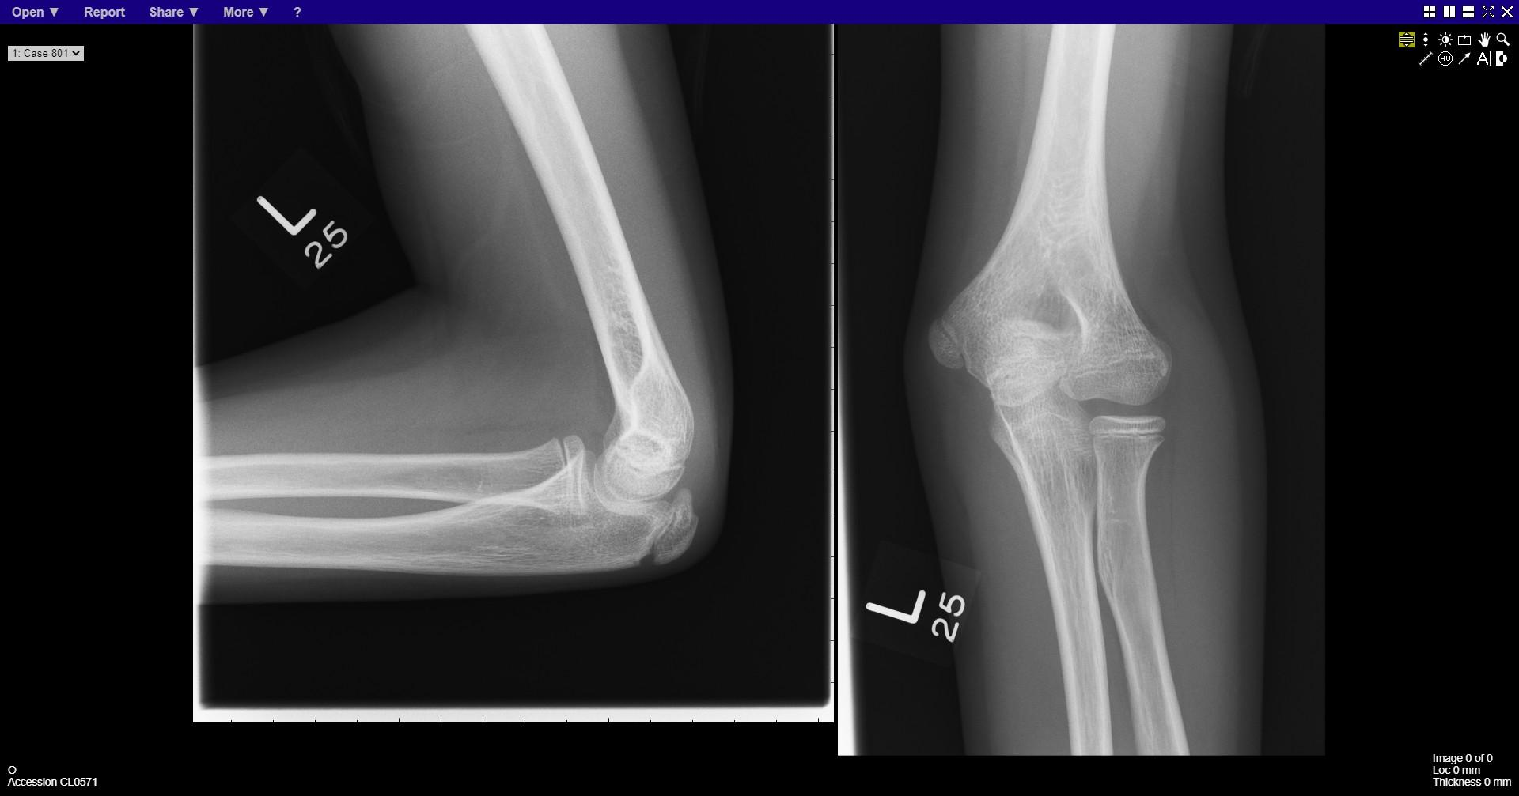
Notes:
normal

Slide 22
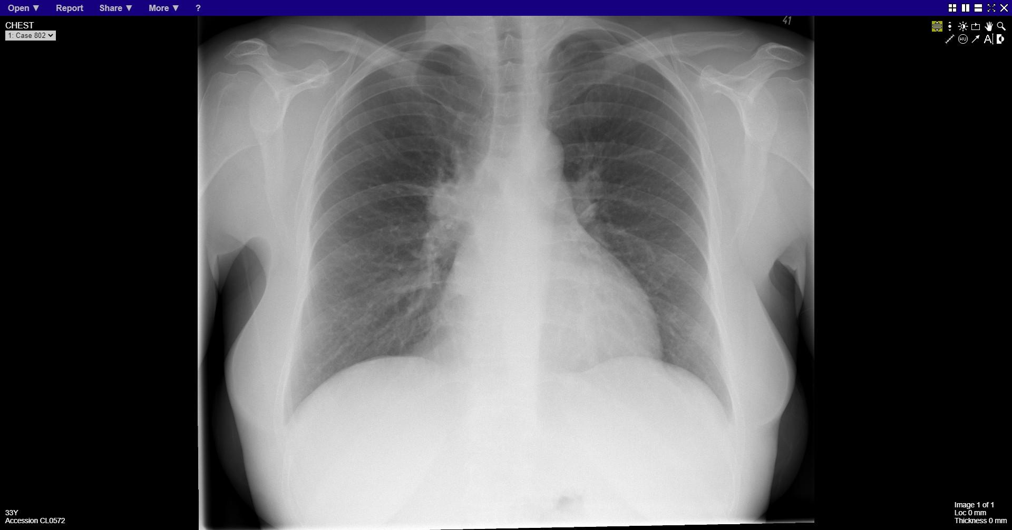
Notes:
Right hilar mass

Slide 23
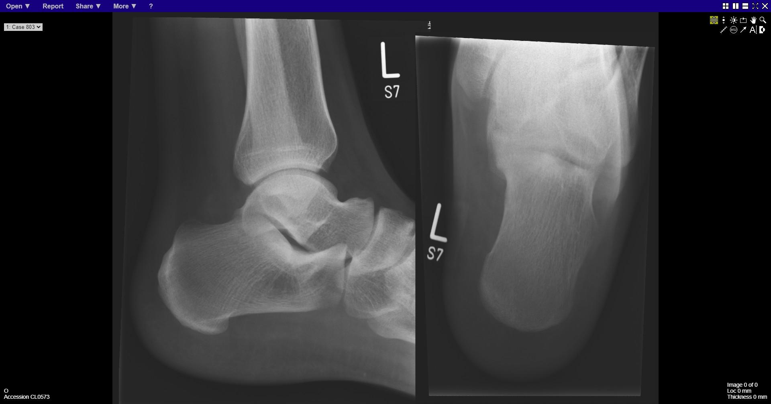
Notes:
normal

Slide 24
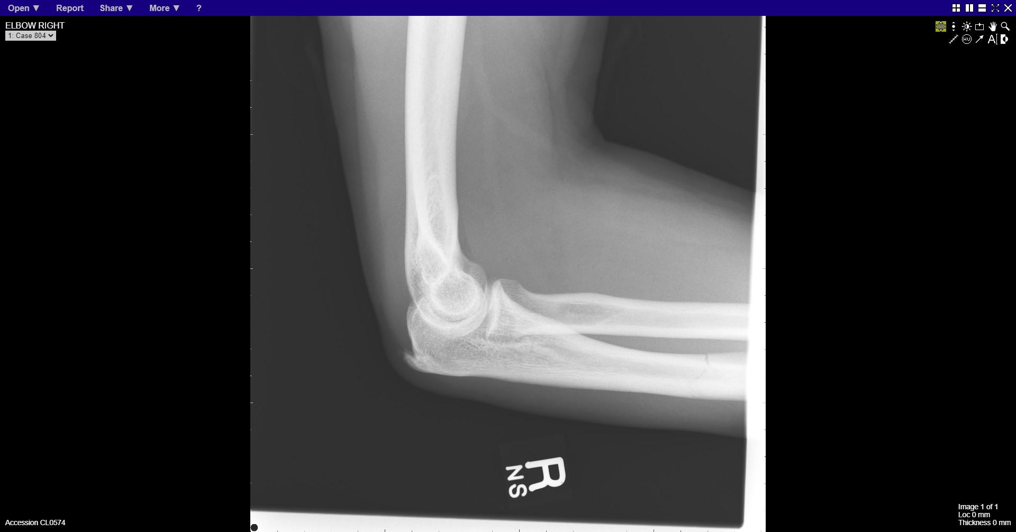
Notes:
Ulna fracture

Slide 25
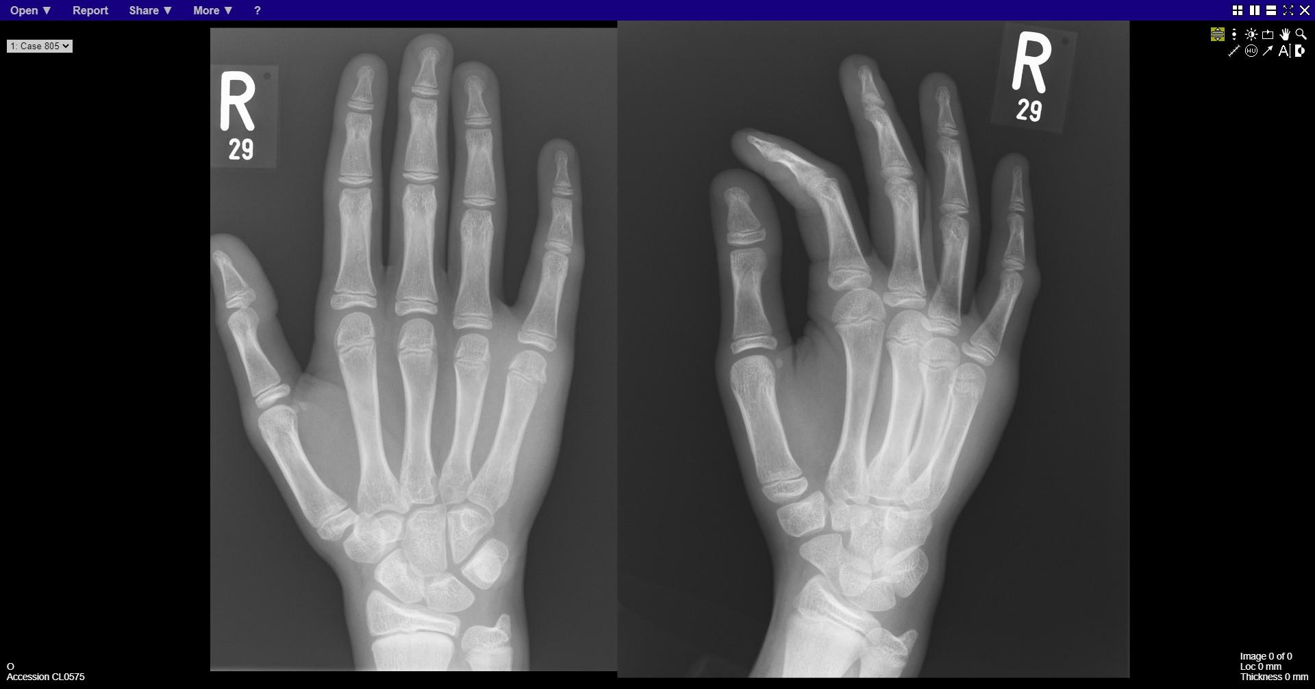
Notes:
Fracture distal 5th metacarpal

Slide 26
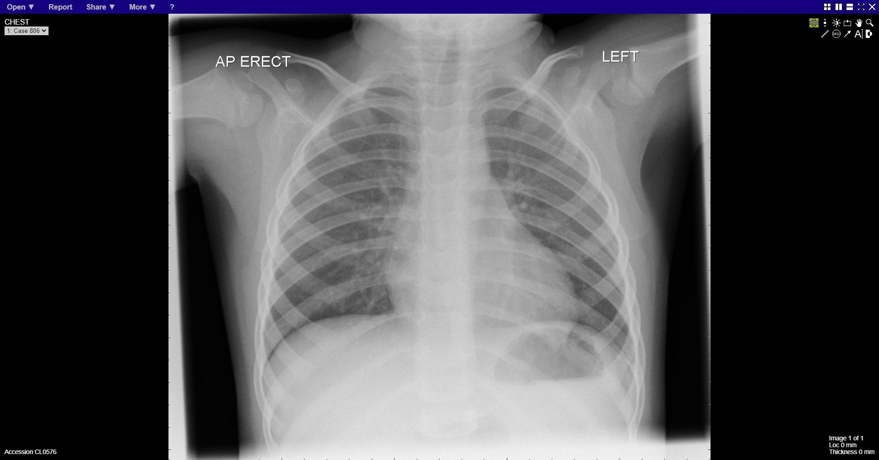
Notes:
Croup
Gas in left GH joint is normal in child

Slide 27
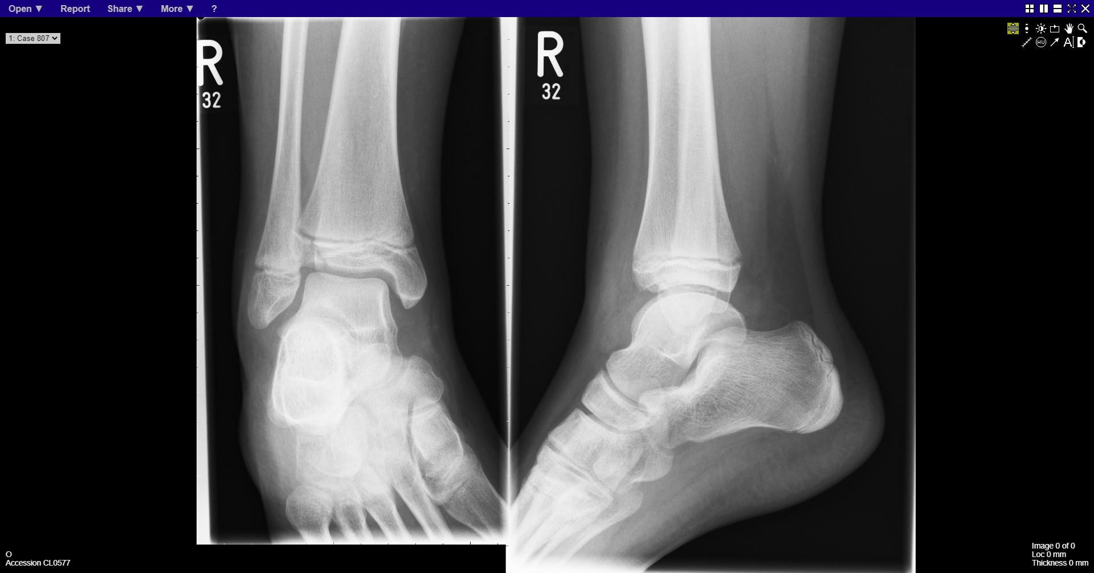
Notes:
Fracture distal tibia – SH3

Slide 28
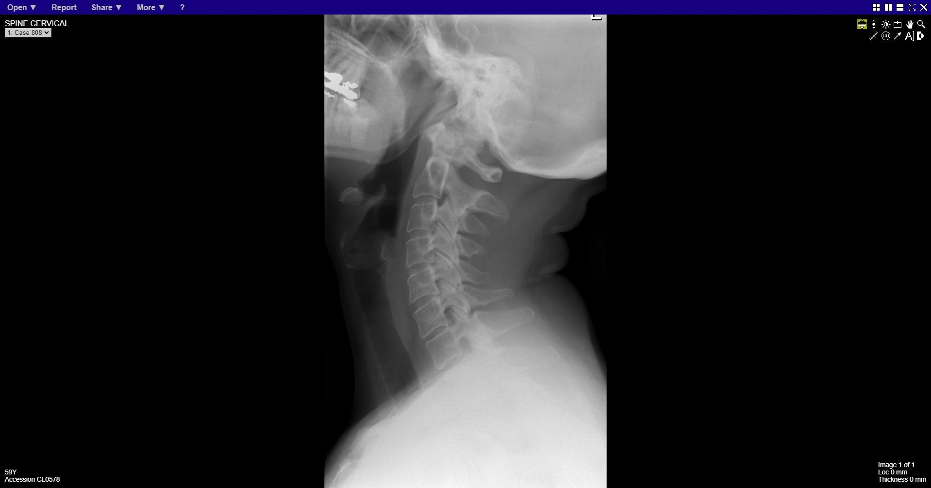

Slide 29
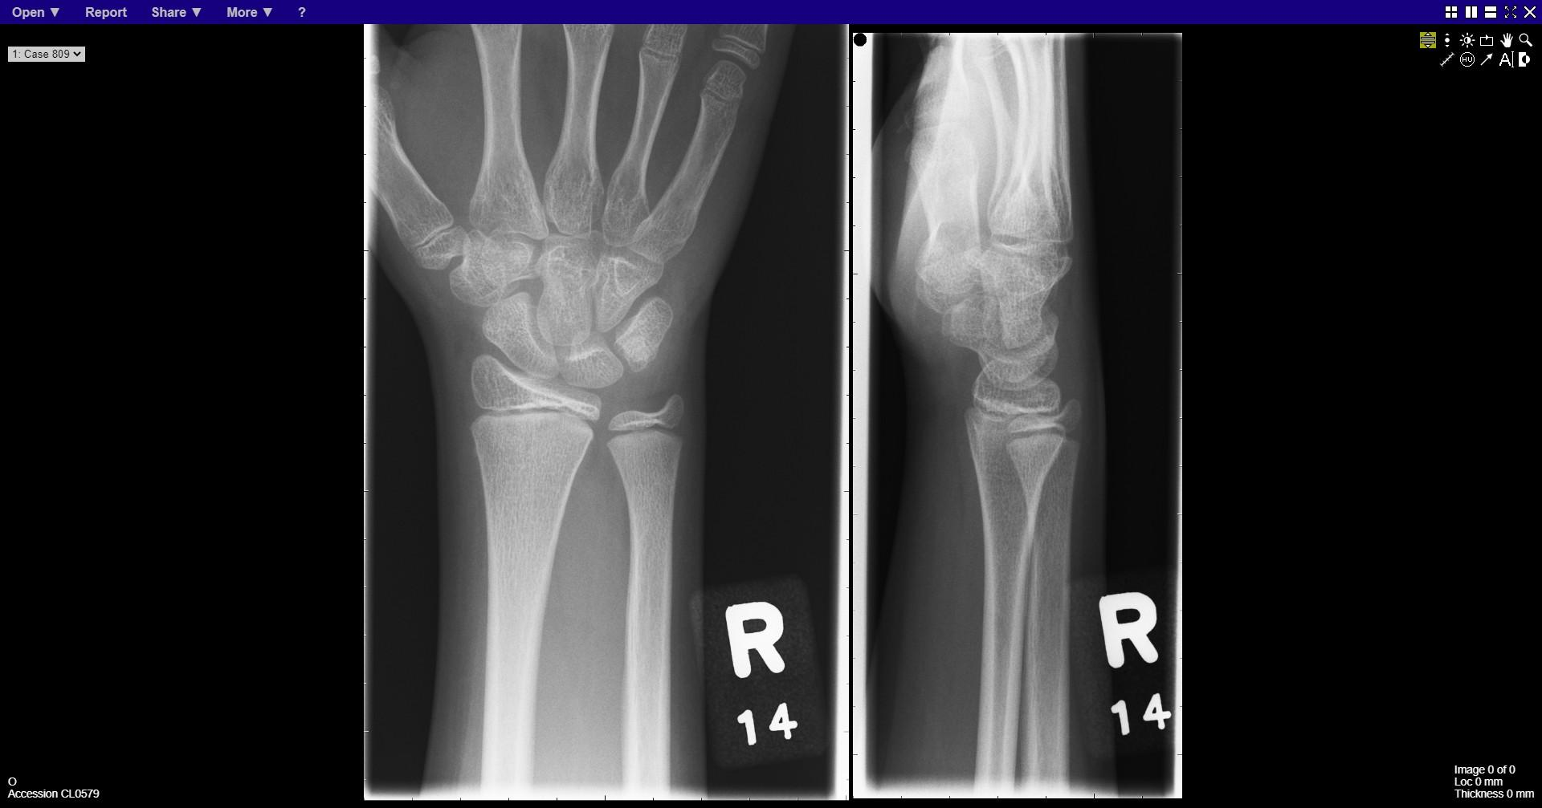
Notes:
Greenstick fracture distal radius

Slide 30
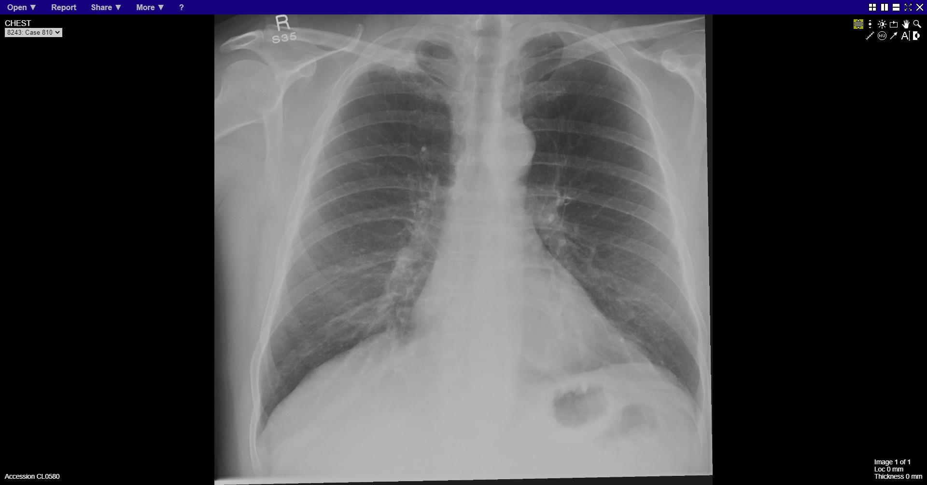
Notes:
Right apical mass

